Slide 1
Introduction to Microservices & Devops

Slide 2
Microservices
Micro services is a service-oriented architecture pattern wherein applications are built as a collection of various smallest independent service units.
Microservice Architecture is an architectural development style that allows building an application as a collection of small autonomous services developed for a business domain.
Monolithic architecture is like a big container in which all the software components of an application are clubbed into a single package .
In a Microservice, every unit of the entire application should be the smallest, and it should be able to deliver one specific business goal In Monolithic architecture, large code base can slow down the entire development process. New releases can take months. Code maintenance is difficult.

Slide 3
Microservice architecture is a form of service-oriented architecture (SOA) whereby software applications are built as a collection of loosely coupled services, as opposed to one monolithic software application. Each microservice can be created independently from the other, or even in a completely different programming language and run on their own.
At the core of it all, each microservice tries to satisfy the specific user story or business requirement that you‘re working on.
A popular way to implement microservices is to use protocols such as HTTP/REST alongside JSON, as an architectural design pattern

Slide 4
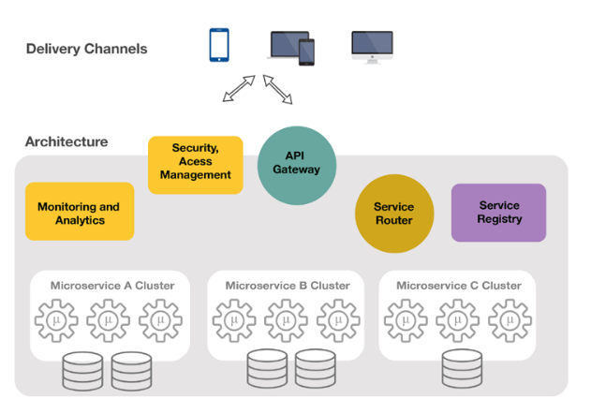
Microservice Architecture

Slide 5
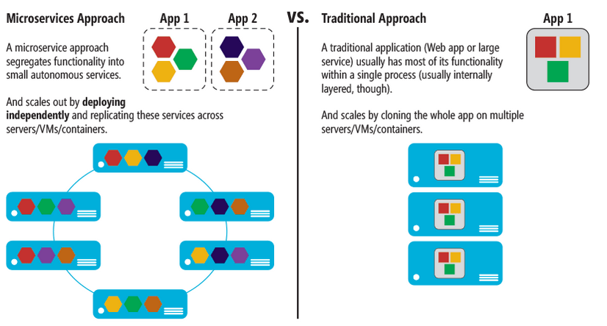
Benefits of Microservice Architecture

Slide 6
API gateway
API Gateway. The API gateway is the entry point for clients. Instead of calling services directly, clients call the API gateway, which forwards the call to the appropriate services on the back end.
Advantages of using an API gateway include:
It decouples clients from services. Services can be versioned or refactored without needing to update all of the clients.
Services can use messaging protocols that are not web friendly, such as AMQP.
The API Gateway can perform other cross-cutting functions such as authentication, logging, SSL termination, and load balancing.

Slide 7
Deployment patterns
Multiple service instances per host - deploy multiple service instances on a host
Service instance per host - deploy a single service instance on each host
Service instance per VM - a specialization of the Service Instance per Host pattern where the host is a VM
Service instance per Container - a specialization of the Service Instance per Host pattern where the host is a container

Slide 8
It is a fairly traditional approach where you have a machine which could be physical or virtual and you run multiple service instances on this host. Each service instance could be a process like JVM or Tomcat instance, or each process may be comprised of multiple service instances. For example, each service instance could be a var file and you run multiple var files on one tomcat Some of the benefits of using this pattern are
Efficient resource utilization: You have one machine with multiple services and the whole resource is shared between these different services
Fast deployment: In order to deploy a new version of your service you simply have to copy that to the machine and restart the process

Slide 9
Some of the drawbacks of using this pattern are :
You get little to no isolation between various service instances
Poor visibility on how the services are behaving like memory and CPU utilization
Difficult to constrain the resources a particular service can use
Risk of dependency version conflicts

Slide 10
To have a greater isolation and manageability we can host a single service instance in a single host at the cost of resource utilization. This pattern can be achieved by two different ways: Service Instance per Virtual Machine and Service Instance per Container

Slide 11
Service Instance per Virtual Machine
Some of the benefits of packaging services as virtual machines are :
You get great isolation as the virtual machines are highly isolated with each other
You get greater manageability as virtual machine environment has great tools for management
Virtual machine encapsulates the implementation technology for the microservice. Once you package the service, the API for starting and stopping the service is your virtual machine interface. The deployment team need not to be knowledgeable about the implementation technology
With this pattern you can leverage cloud infrastructure for auto-scaling and load balancing
Some of the drawbacks of using this pattern are :
With virtual machines, we get less efficient resource utilization and thus increases the cost
The process of building a virtual machine image is relatively slow because of the volume of the data needed to be moved around the network and thus slows the deployment process

Slide 12
Service Instance per Container
Some of the benefits of packaging services as container are :
Greater isolation as each container is highly isolated from each other at OS level
Greater manageability with containers
Container encapsulates the implementation technology
As containers are lightweight and sharing the same resources, it has efficient resource utilization
Fast deployments
Some of the drawbacks of packaging services as container are :
As the container technology is new, it is not that much mature compared to virtual machines.
Containers are not as secured as VMs

Slide 13
serverless deployment
The serverless deployment hides the underlying infrastructure and it will take your service’s code just run it. It is charged on usage on how many requests it processed and based on how much resources utilized for processing each request.
To use this pattern, you need to package your code and select the desired performance level. Various public cloud providers are offering this service where they use containers or virtual machines to isolate the services which are hidden from you.
In this system, you are not authorized to manage any low-level infrastructure such as servers, operating system, virtual machines or containers. AWS Lambda, Google Cloud Functions, Azure Functions are few serverless deployment environments.

Slide 14
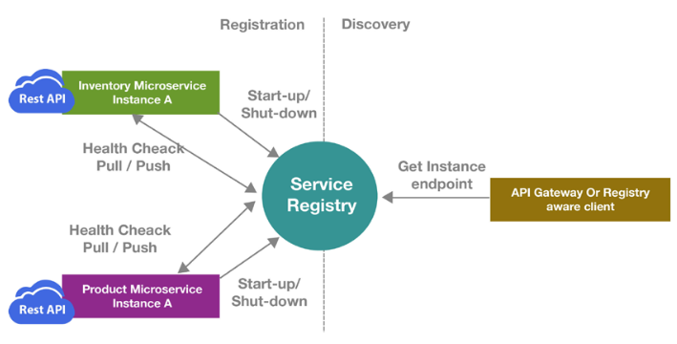
Service Registry

Slide 15
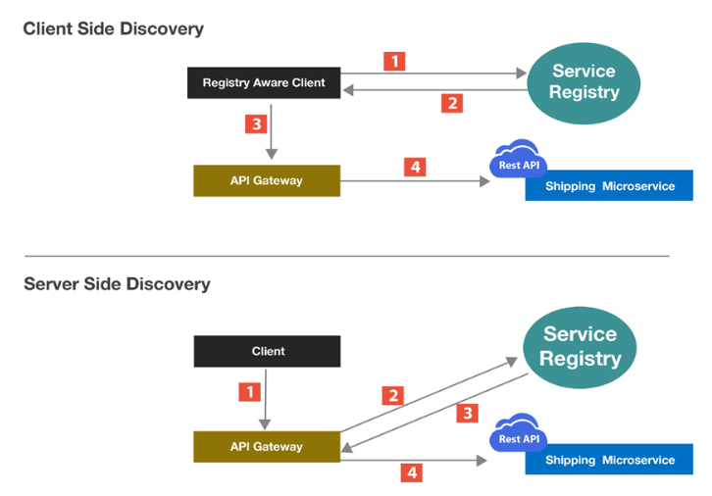
Service Discovery

Slide 16
In a microservices application, the set of running service instances changes dynamically. Instances have dynamically assigned network locations. Consequently, in order for a client to make a request to a service it must use a service-discovery mechanism.
A key part of service discovery is the service registry. The service registry is a database of available service instances. The service registry provides a management API and a query API. Service instances are registered with and deregistered from the service registry using the management API. The query API is used by system components to discover available service instances.

Slide 17
There are two main service-discovery patterns: client-side discovery and service-side discovery. In systems that use client-side service discovery, clients query the service registry, select an available instance, and make a request. In systems that use server-side discovery, clients make requests via a router, which queries the service registry and forwards the request to an available instance.

Slide 18
Netflix OSS provides a great example of the client-side discovery pattern.
The AWS Elastic Load Balancer (ELB) is an example of a server-side discovery router. An ELB is commonly used to load balance external traffic from the Internet.

Slide 19
There are two main ways that service instances are registered with and deregistered from the service registry. One option is for service instances to register themselves with the service registry, the self-registration pattern. The other option is for some other system component to handle the registration and deregistration on behalf of the service, the third-party registration pattern.
In some deployment environments you need to set up your own service-discovery infrastructure using a service registry such as Netflix Eureka, etcd, or Apache Zookeeper. In other deployment environments, service discovery is built in. For example, Kubernetes and Marathon handle service instance registration and deregistration. They also run a proxy on each cluster host that plays the role of server-side discovery router.

Slide 20
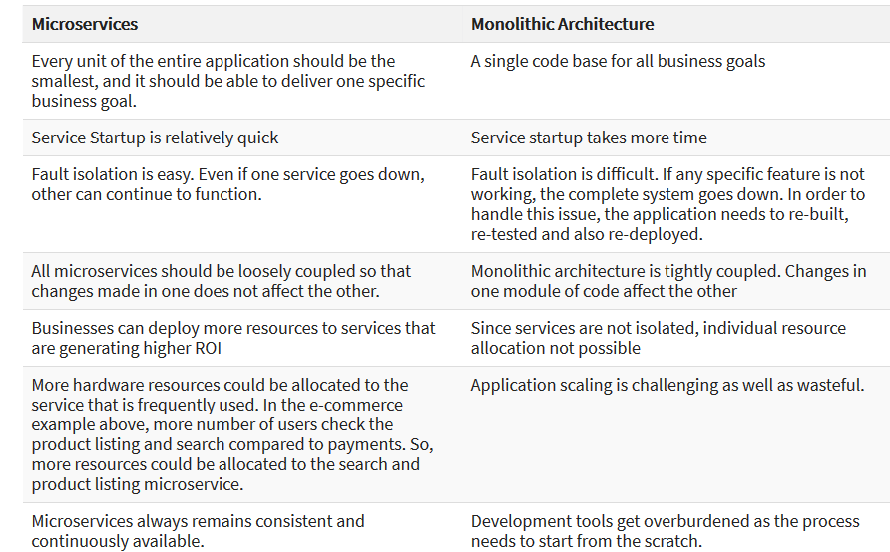

Slide 21
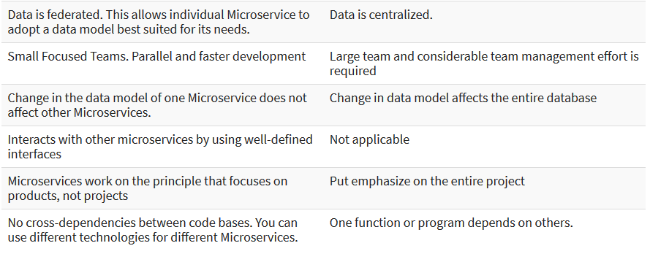

Slide 22
Databases
Each microservice should have its own database and should contain data relevant to that microservice itself. This will allow you to deploy individual services independently. Individual teams can now own the databases for the corresponding microservice.
Microservices should follow Domain Driven Design and have bounded contexts. You need to design your application based on domains, which aligns with the functionality of your application. It's like following the Code First approach over Data First approach - hence you design your models first. This is a fundamentally different approach than the traditional mentality of first designing your database tables when starting to work on a new requirement or greenfield project. You should always try to maintain the integrity of your Business model.

Slide 23
Databases
Databases should be treated as private to each microservice. No other microservice can directly modify data stored inside the database in another microservice.
Event-Driven Architecture is a common pattern to maintain data consistency across different services. Instead of waiting for an ACID transaction to complete processing and taking up system resources, you can make your application more available and performant by offloading the message to a queue. This provides loose coupling between services.
Messages to the queues can be treated as Events and can follow the Pub-Sub model. Publishers publishes a message and is not aware of the Consumer, who has subscribed to the event stream. Loose coupling between components in your architecture enables to build highly scalable distributed systems.

Slide 24
A basic principle of microservices is that each service manages its own data. Two services should not share a data store. Instead, each service is responsible for its own private data store, which other services cannot access directly.
The reason for this rule is to avoid unintentional coupling between services, which can result if services share the same underlying data schemas. If there is a change to the data schema, the change must be coordinated across every service that relies on that database. By isolating each service's data store, we can limit the scope of change, and preserve the agility of truly independent deployments. Another reason is that each microservice may have its own data models, queries, or read/write patterns. Using a shared data store limits each team's ability to optimize data storage for their particular service.

Slide 25
INTRODUCTION TO DevOps
DevOps is a culture which promotes collaboration between Development and Operations Team to deploy code to production faster in an automated & repeatable way. The word 'DevOps' is a combination of two words 'development' and 'operations.'
DevOps helps to increases an organization's speed to deliver applications and services. It allows organizations to serve their customers better and compete more strongly in the market.

Slide 26
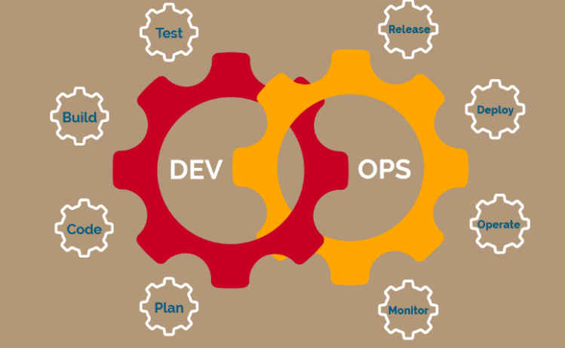

Slide 27
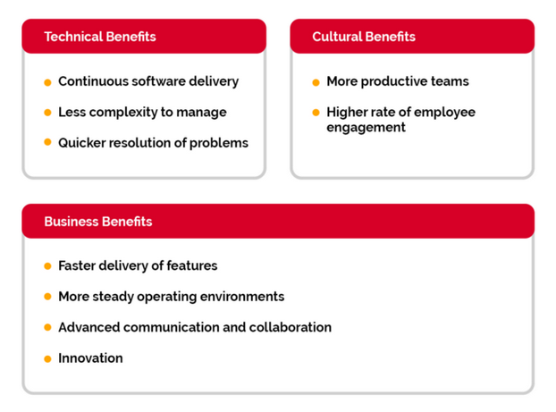
Why You Need DevOps?

Slide 28
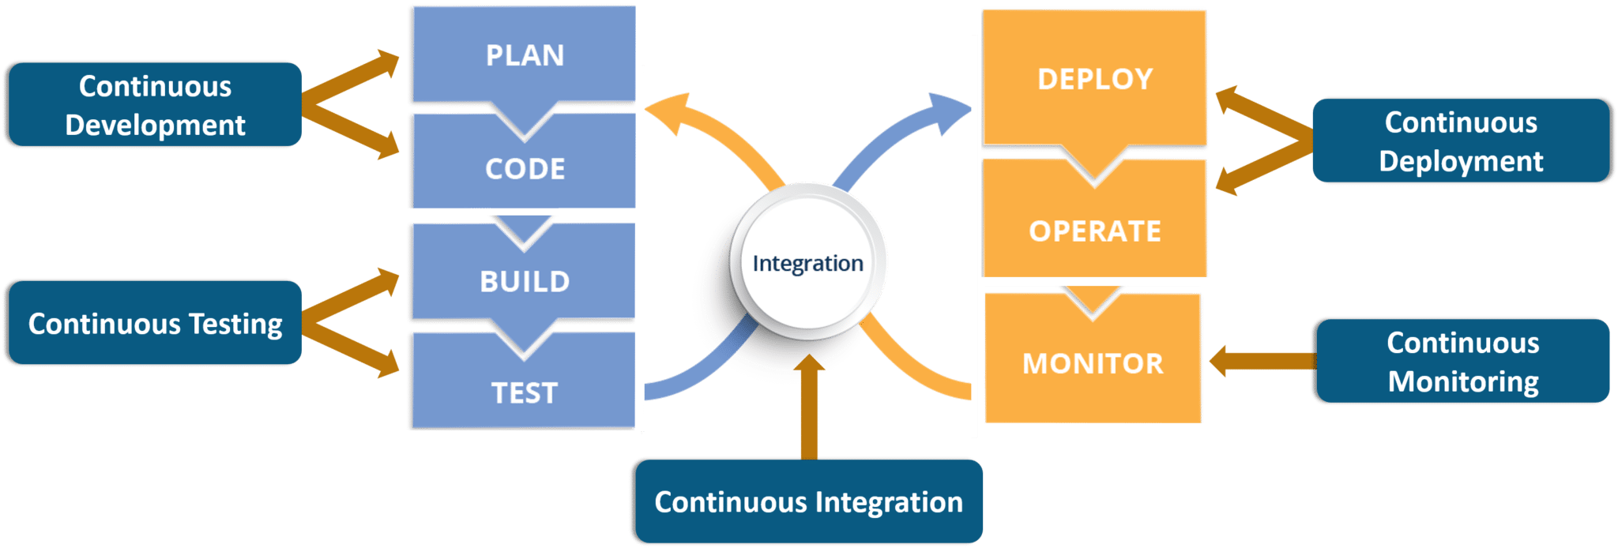

Slide 29
DevOps ecosystem
Plan
This stage is composed of two phases: Define and Plan. This stage refers to the business value and application requirements. Considering agile process, you should use tools that allow your development team to plan in iterations. You can learn from the users at an early stage and can optimize the product. Always consider tools that offer sprint planning features. During this stage, it is necessary that everyone can share and discuss anything: ideas, strategies, goals, requirements, roadmaps, and documentation. This phase includes:
Production metrics, objects and feedback
Requirements
Business metrics
Update release metrics
Release plan, timing and business case
Security policy and requirement
Tools used: JIRA ,Rally, Trac, Redmine

Slide 30
2. Create
The second phase of DevOps is create. This is comprised of building, coding, and configuring the development process. Tools used in this category often overlap with other categories. As DevOps is breaking silos down, this impact the activities and solutions. Activities which comes under this stage are:
Design of the software and configuration
Coding including code quality and performance
Software build and build performance
Release candidate
Tools used: Gradle, Apache Maven, Grunt, WebPack, Github, Bitbucket, Docker, BuildMaster, Slack

Slide 31
3. Test
Testing is one of those functionalities which had shift left due to DevOps. The quality aspect of the software depends on the efficiency of testing. As continuous integration has numerous goals for the testing phase, testing should be always automated to assure a seamless flow, sharp and detailed results, and fair affirmation of the application. Early stage testing, initial validation and frequent testing ensure quality built-in to the application can be verified and issues to be tackled early. Testing is directly associated with ensuring the quality of the software release; activities designed to ensure code quality is maintained and the highest quality is deployed to the production. The main activities in this are:
Acceptance testing
Regression testing
Security and vulnerability analysis
Performance
Configuration testing
Tools used: JIRA issue tracking, Bugzilla, Selenium, Mocha, Jasmine, JUnit, NUnit, JMeter, pytest, BlazeMeter, Load Impact

Slide 32
4. Packaging
Packaging phase starts once the release is ready for deployment. This stage is often referred to as Preproduction/preprod. The packaging stage comprises tools for package repositories and other storage mechanisms for the binaries created in the development stage. Repositories, also known as artifact or asset repositories — include all assets needed and connected with binaries to facilitate the deployment, such as scripts, configuration files, and additional infrastructural files. Packaging consists of following activities;
Approval/preapprovals
Package configuration
Triggered releases
Release staging and holding
Tools used: Dockers, consul.io, Ansible, SaltStack, Puppet, Chef

Slide 33
5. Release
Release includes schedule, orchestration, provisioning and deploying software into production and targeted environment. Part of this process is application release automation tools that help up the packaging and deploying the application from development to production, using automation. The specific Release activities include:
Release coordination
Deploying and promoting applications
Fallbacks and recovery
Scheduled/timed releases
Tools: Jenkins, Kubernetes CI/CD
Jenkins is an open source automation server that offers a plugin architecture to support continuous integration and delivery. It integrates with a variety of software tools in the CI/CD toolchain and distributes work across multiple platforms. In DevOps, Jenkins is been used for packaging, release, and configuration.
Kubernetes is an open-source platform for automating deployments, scaling, and operations of application containers across clusters of hosts, providing container-centric infrastructure.
Other tools used: Dockers, Docker Hub, Docker Swarm, Travis CI, consul.io, Ansible, SaltStack, Puppet, Chef

Slide 34
6. Configure
Configure comes under the operation side of DevOps. Once the software is deployed, you need additional IT infrastructure and configuration. Configuration tools aim to allow the creation of better applications with flexibility, less downtime, and enhancing an overall cost effectiveness for the business. This approach is intended to reduce as many things creating complexity as possible by removing manual configurations. Automation and collaboration are the epicenters in DevOps and this is the reason why configuration is also widely automated across development flows. Specific configuration activities include;
Infrastructure storage, database and network provisioning and configuring
Application provision and configuration
Tools used: Dockers, Jenkins, Kubernetes CI/CD, consul.io, Ansible, SaltStack, Puppet, Chef

Slide 35
7. Monitor
Monitoring is an essential section in a DevOps process. It allows IT team to identify specific issues of specific releases and to know the impact on end-users. There is also an important aspect of making sure organization gets (only) valid data about the process, results in each step, and the outcome.
Monitor related activities are:
Performance of IT infrastructure
End-user response and experience
Production metrics and statistics
Tools: New Relic
New Relic is SaaS web and mobile application performance monitoring tool that gives analytics from the customer experience perspective. It monitors availability, alerting, and notifications in real time for applications running in the cloud, on-premise, or hybrid environments.
Other tools used: Firebase Analytics, crashlytics, ELK stack — Data/BI analytics, Sumologic, Nagios, JIRA, Telegram, Slack

Slide 36
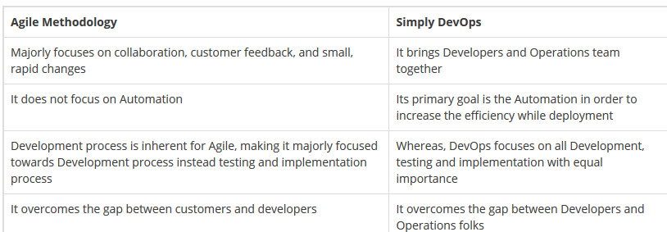

Slide 37
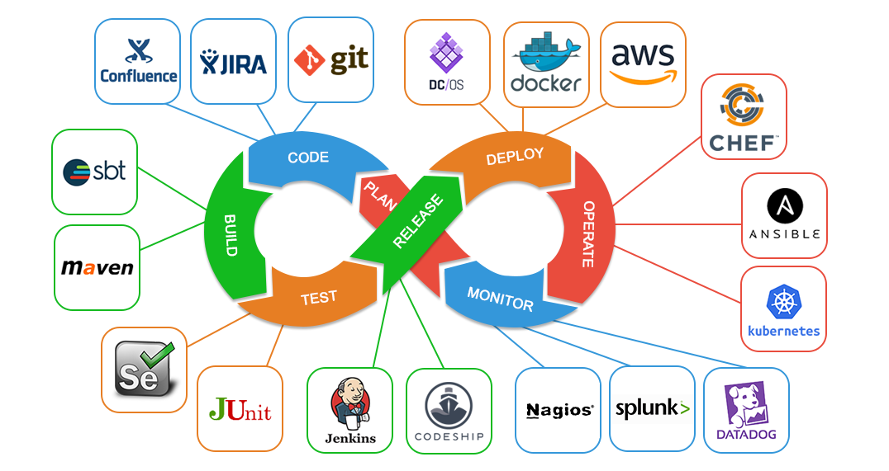
DevOps ecosystem

Slide 38
Different Lifecycle Stages
Different stages in DevOps Lifecycle which contributes to the consistent software development lifecycle:
Continuous Development
Continuous Integration
Continuous Testing
Continuous Monitoring
Virtualization and Containerization

Slide 39
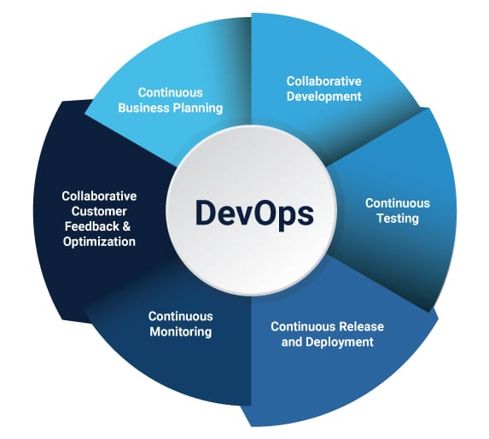

Slide 40
Continuous Development:
In Waterfall Model, your software product parts get broken into multiple pieces or sub-parts for the short development cycles but in this stage, your software is getting developed continuously.
Tools used:
As we Code & Build in this stage, so one can use GIT to maintain the different versions of the code and to build/package the code into an executable file, we use a reliable tool called as Maven.
Continuous Integration:
In this stage, if your code is supporting a new functionality, it is then integrated with an existing code continuously. As the continuous development keeps on taking place the existing code needs to be integrated with the latest one “continuously”, also the changed code should ensure that there are no errors in the current environment for them to work smoothly.
Tools used:
Jenkins is the tool that is used for the Continuous Integration here, one can pull the latest code from the GIT Repository, of which you can produce the build and deploy on test or the production server.
Continuous Testing:
In this stage, your developed software is being tested continuously to detect the bugs using the several automation tools.
Tools used:
So, for the QA/Testing purposes, one can use the automated tools for it and the tool used widely for automation testing is Selenium, as it lets the QAs to test the codes in parallel fashion to ensure that there is no error, in-competencies or flaws in the software.
Continuous Monitoring:
Continuous monitoring is a very crucial part of the DevOps life-cycle where it helps in providing the important information which basically helps you to ensure the service up-time and the optimal performance. The operations team get the results from the reliable monitoring tools to detect and fix the bugs/flaws in the application.
Tools used:
Several tools like Nagios, Splunk, ELK Stack and Sensu are used for monitoring the application. They help you to monitor your application and servers closely to check their health and if they are operating actively or not, any major issue detected by these tools are forwarded to the developer’s team for them to fix them in the continuous development phase.

